Slide 1


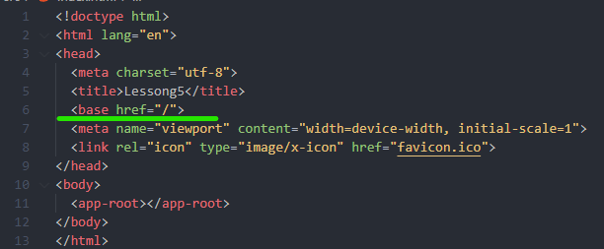
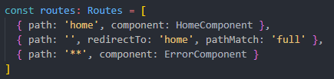
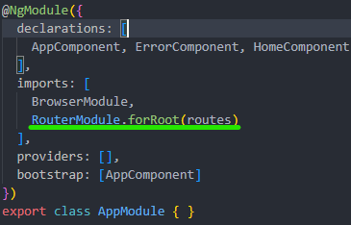


Router basics
1
2
4
3

Slide 2
Navigation between routes
Router
Router link
Absolute path
Relative path

Slide 3

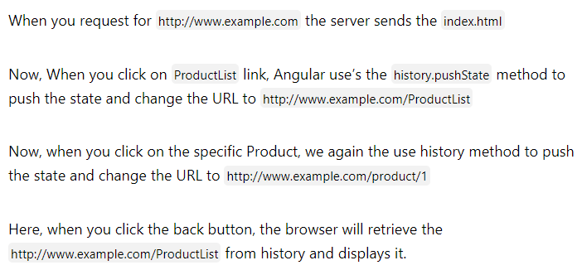
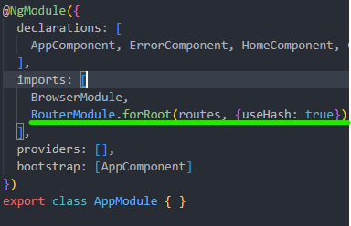
Location Strategies
Hash Location Strategy
Path Location Strategy (default)

Slide 4





Router options and anchors
1
3.b
2.a
(only for base urls)
2.b
3.c
2.c

Slide 5
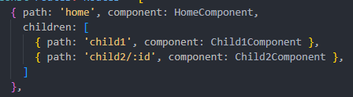

Children routes
2
1

Slide 6
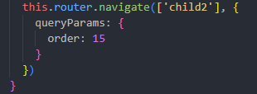

Pass and get params and query params from route
Query Params
Route params
1 .а
1.а
1.б
1.б
2
2

Slide 7
Query Params Handling
null
Preserve
Merge

Slide 8
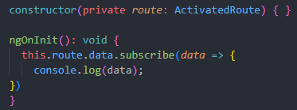
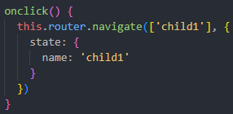

Pass and get dynamic\static data
Static data
Dynamic data
1
1.а
2
1.б
2

Slide 9
Lazy loading
Create module that should be lazy loaded
Add route with ‘ ’ path to RouterModule (forChild)
Add lazy loaded route (loadChildren) to routes
Add routerNavigate/routerLink to navigate to that path

Slide 10
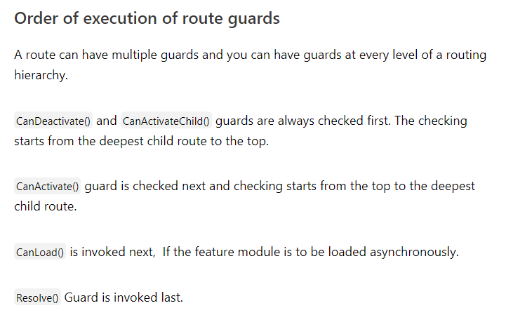
Angular guards
CanActivate
CanDeactivate
Resolve
CanLoad
CanActivateChild
Create guard service
Add it to providers in module
Add it to route path

Slide 11
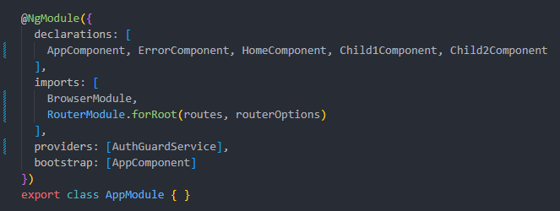
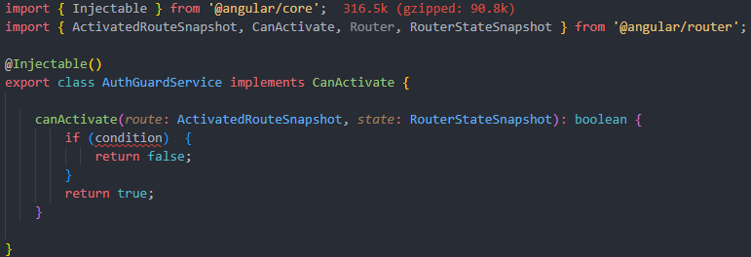
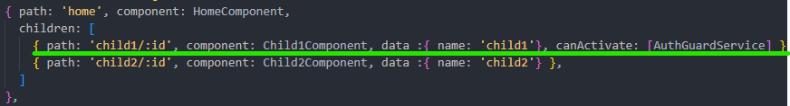
Can activate guard
2
1
3

Slide 12
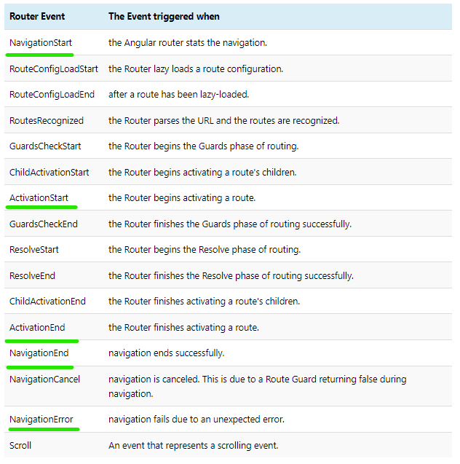
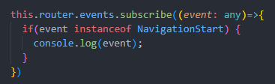
Router events

